Slide 1

A SURVEY ON WIRELESS SENSOR NETWORK
SECURITY
PRESENTED BY:
Aashika Lakhani, Dhruv Haribhakti, Mahima Shukla,
Venkatesh Galla, Akshayaa Venkatesan

Slide 2
Wireless Sensor Network (WSN)
Sensors have been an old concept of devices used to measure and detect events.
Sensors can be wired as well as wireless.
A network consisting of wireless sensors, actuators and other connecting nodes is called the Wireless Sensor Network.
WSN usually consists of Sensing devices, a Base station and Internet.
The Sensors need a central Hub which controls the exchange of data between the sensors and the Internet.
All the devices can be monitored over a dashboard with the help of a mobile or web application.

Slide 3
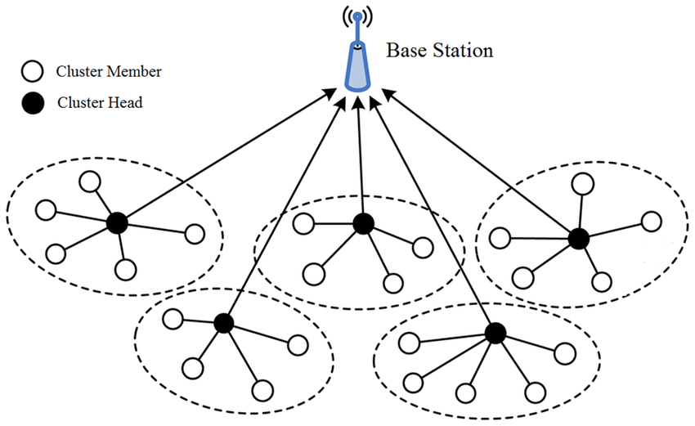
Wireless Sensor Network (WSN)

Slide 4
Networking Protocols
Zigbee – It works under 802.15.4 standard. It has low power, low cost and low data rates for the devices. The devices have operating frequencies at 868MHz, 915MHz and 2.4GHz. The devices have a range of 10-100m.
Z-Wave – The devices have a constant data rate of 40kbps. They operate at 908.42 MHz in the US and 868.42 MHz in Europe. The devices have a range up to 30m.
WiFi – It works under 802.11n/a/b/g standards. The devices operate at frequencies of 2.4GHz and 5HGz. The devices have a range of 35-100m.
Bluetooth – It works under 802.15.1 standard. Usually used for P2P communication for a short range up to 10m. It works on 2.4Ghz-2.483GHz band.

Slide 5
Topology
Peer to Peer (P2P): Central hub is not required. Sensors communicate to any other sensor directly.
Star Network: Needs a Central Hub for communication between the nodes.
Tree Topology: Needs a Central Hub as well. There are end devices which can communicate to the Hub through the routing devices.
Mesh Network: Central Hub is not required. Nodes can directly communicate to all the other nodes directly.

Slide 6
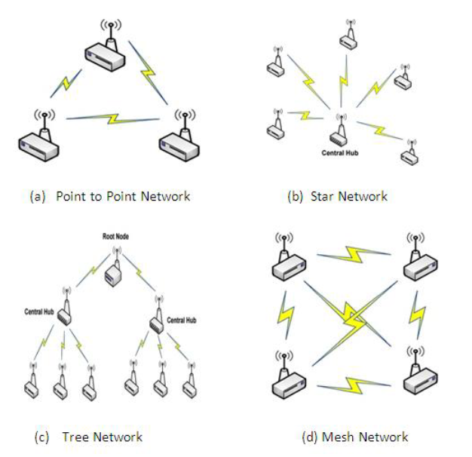
Topology

Slide 7
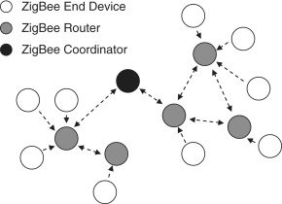
Zigbee network has a tree topology

Slide 8
Which topology to choose?
Energy Efficiency: The three components of information sensing, data transfer, and data processing are where the majority of the energy used by sensor circuits is expended.
Node Localization: Localization system needs to be reasonably environment-adaptable.
Data fusion: Edge computing is an important factor to consider before the data transfer.
Network Security: The field-installed devices need to be safe from any natural intrusion from animals or insects and disasters.

Slide 9
Types of sensors
Proximity Sensor – detects nearby objects
Motion Sensor – detects the presence or motion of a human or an object
Velocity Sensor – calculates the rate of change in the position
Temperature Sensor – detects the temperature of a room or an object
Pressure Sensor – detects the change in force
Humidity Sensor – detects the humidity
Flood detection Sensor – detects if the water level rises above a specific height
Gas Sensor – detects the presence of any specific gas

Slide 10
Routing Protocols
Routing protocols are necessary for communication and sending data from one node to another. Classification of routing protocols can be done into the following categories:
Data Centric Protocol: It is a query based protocol. The data flows from the source sensors to the sink on the base of query.
Hierarchical Protocol: It is used in the cluster based network where each cluster has a cluster-head.
Location based Protocol: It is when the source knows the exact location of the destination node and directly send data to that node using the optimal path.
QoS Aware Protocol: It ensures that the Quality of Service of the data transfer is good. It makes sure that the data transfer has maximum reliability and minimum delay, traffic and energy consumption.

Slide 11
Security Objectives
Confidentiality: To maintain confidentiality, information must not be disclosed to uninvited parties, people, or systems.
Integrity: Integrity refers to prevention of unauthorized individuals or systems from falsifying or altering data that is delivered over a network.
Authentication: the process of determining whether the nodes are true, genuine, or valid.
Availability: The concept of availability refers to making sure that authorised users can access system resources without being blocked by unauthorised systems or people.
Freshness: Freshness refers to freshness of both data and the key.

Slide 12
AES Encryption Algorithm
AES/Rijndael is an iterated block cipher, meaning that the initial input block and cipher key undergoes multiple rounds of transformation before producing the output.
The encryption process uses a set of specially derived keys called round keys.
These are applied, along with other operations on an array of data that holds exactly one block of data to be encrypted. This array we call the state array.

Slide 13
AES Encryption Algorithm
The following are the steps to encrypt a 128-bit block:
Derive the set of round keys from the cipher key.
Initialize the state array with the block data (plaintext).
Add the initial round key to the starting state array.
Perform nine rounds of state manipulation.
Perform the tenth and final round of state manipulation.
Copy the final state array out as the encrypted data (cipher text).
Each round of the encryption process requires a series of steps to alter the state array. These steps involve four types of operations called:
Sub Bytes
Shift Rows
Mix Columns
Add Round Key

Slide 14
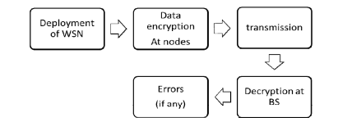
New Optimal Encryption Method
A Low complexity security algorithm:
A low complexity security algorithm is proposed for WSN that provides data confidentiality.
The model on which this security algorithm is implemented consists of a base station and N sensor nodes.
‘N’ can vary as per the requirement.
The nodes sense the data from the surrounding and route it back to the base station.
The sensed data are confidential thus needs to be protected from being disclosed to opponent or attacker.

Slide 15
Some Common cheap dirty tricks
Sniff the Key Exchange while the device setup and initiate the MitM Attacks: use sniffing softwares like Wireshark, Ubiqua, NetworkMiner, Fiddler etc. to read the key exchange when the sensor is added to the network. The key is usually encrypted which is usually easy to decrypt after a few key exchanges.
Use a jammer to freeze the network and affect the availability of the network: This method is usually used to freeze the network and implement a DoS attack. The jammer can be easy available in the market. The attacker just needs to know the sensor types.

Slide 16
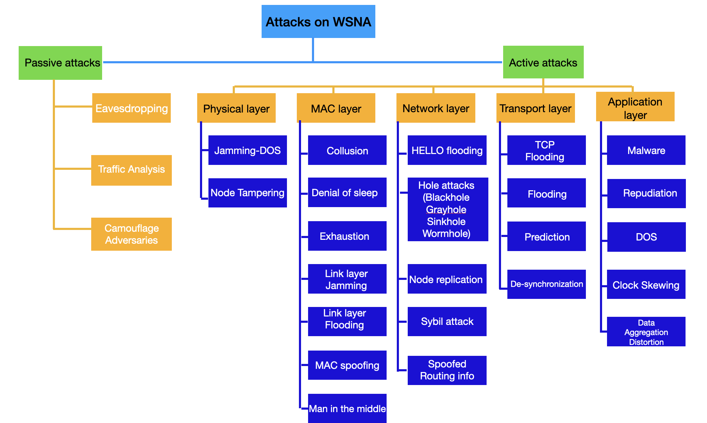
Types of attacks in WSN

Slide 17
Passive Attacks
Attacker monitor the transmission illegally and analyze traffic through which data are transfer and it does not change or modify the data like an active attacks.
﻿﻿Passive attacks are classified into two categories
﻿﻿Attacker access the file being transferred
﻿﻿Attacker analyzes the traffic pattern and tries to find out the identity of the sender and receiver and the frequency of transmission. These information will be useful in future attack
The main intensions of passive attack are
﻿﻿Stealing sensitive information
﻿﻿Compromised the privacy requirements
﻿﻿Performance degradation
Eavesdropping is the most common passive attack.

Slide 18
Eavesdropping
This attack is most common and easiest attack on privacy.
In this attack an adversary snoop the data, by snooping those data an adversary easily understands message contents.
Interception of WSN messages may expose the following useful information: physical location of certain nodes such as cluster leaders, gateways, key distribution centres, and so on, message identities (IDs), timestamps, other fields, and basically everything that is not encrypted.

Slide 19
Traffics Analysis
In this attack an adversary analyze traffic that can provide valuable information about wireless sensor network and identify some sensor nodes that plays an important role in WSN.
For instance, in WSNs, the sink nodes produce more transmissions than the other nodes because they relay more packets than the nodes farther from the base station.
This attack may create Denial of Service (Dos) attack and attack on those node which plays an important role.

Slide 20
Camouflage Adversaries
In this attack an adversary either inserts a sensor node or compromises a sensor node in wireless sensor network.
Camouflage node then publishes a false advertisement regarding the routing information, causing packets from other nodes to be routed through the compromised node
When packets are received, they are routed to a strategic node where privacy evaluations of packets are performed routinely.

Slide 21
Active Attacks
Active attacks includes - inserting error files into system, packet alternation, modification, illegal access, overloading the sensor network.
Main targets of active attacks are -
Interfering with the functionality of the system
Reduction of some sensor nodes from the network
Data modification
Denial of Service
Performance degradation of the whole system

Slide 22
Denial of Service (DoS) Attack:
DoS attack targets the resources of wireless sensor network
Wireless sensor nodes are resource constrained devices.
Attacker continuously sends unnecessary packets.
Main intension of attacker is to consume the available resources of the network, so that the legitimate users cannot access them.
The target resources can be network bandwidth, power, memory etc.

Slide 23
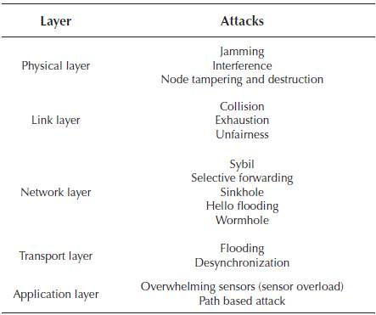
Jamming attack
﻿﻿Major physical layer DoS attack
﻿﻿Radio frequency is diverted to other nodes
﻿﻿The data transmission is delayed.
WSN nodes have limited resources - cannot employ spread spectrum technology
﻿﻿If jamming attack is detected, the sensor nodes go to sleep mode and wake up cyclically to check the channel.
﻿﻿This cannot avoid DoS attack. It enhances the lifespan of sensor nodes by decreasing the power consumption.
Most common DOS attacks according to protocol stack layers

Slide 24
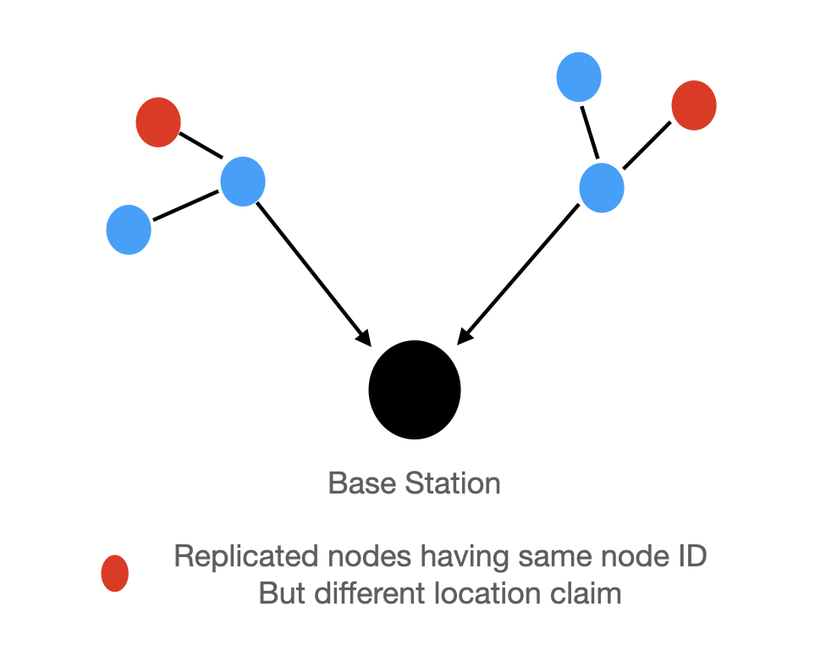
Node Replication Attack
Attacker attacks a sensor node in the network.
From the compromised node, attacker steals the secret information.
After getting the secret information, attacker duplicates the node and the duplicate nodes (Cloned nodes) are employed in the sensor network
The duplicate nodes behave like the original node.
The cloned node sends sensitive information to the attacker.
Sometimes attacker can clone the base station which is serious threat to WSN.

Slide 25
Attacks on Information in Transit
﻿﻿The information in transit pass from one sensor node to other.
﻿﻿The passing data may be modified, altered, spoofed or deleted.
﻿﻿WSN in vulnerable to eavesdropping attacks.
﻿﻿Attacker can monitor the traffic and alter the packets.
﻿﻿Analysis of the traffic of the sensor network is a serious threat to wireless sensor network.

Slide 26
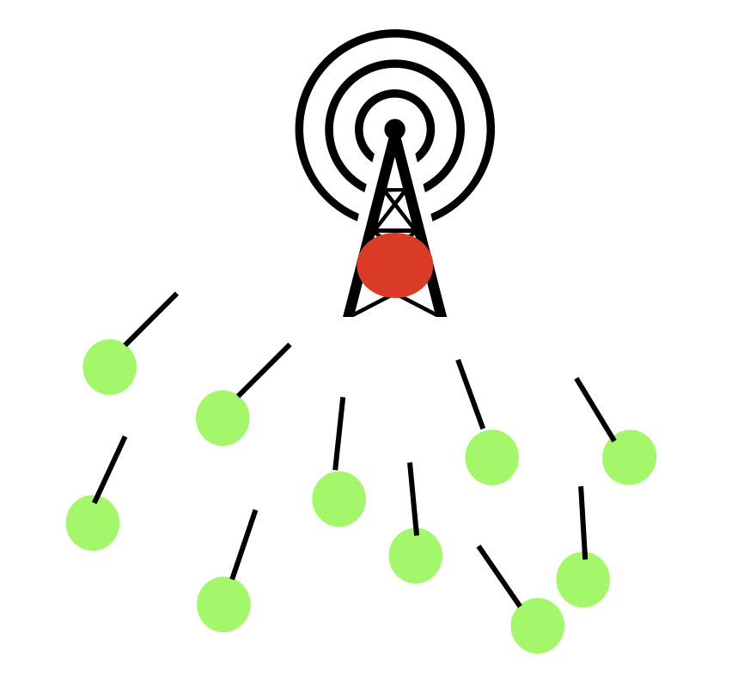
Routing Attacks:
Hello Flood:
Attacker employs a high-power transmitter which sends 'hello' packets constantly.
The nodes which receives these 'hello' packets, assume that the received packets come from neighboring node.
The nodes start communicating with the attacker.
Attacker gains control over the network

Slide 27
Routing Attacks
Spoofing Attack:
In spoofing attack, message is altered during transmission.
Receiver receives inaccurate information.
Routing action becomes different, data must travel long distance.
Consumes power of wireless sensor network.
One common solution to tackle this spoofing attack is to apply different integrity checking mechanisms like message authentication code (MAC)

Slide 28
Routing Attacks
Replay Attack:
In Replay attack, same old message is sent repeatedly over the wireless sensor network.
The bandwidth of the sensor network degrades.
To overcome this attack timestamp or nonce is used with encryption algorithm to identify the old message. Timestamp is more preferred as it requires lesser number of messages compared to nonce.

Slide 29
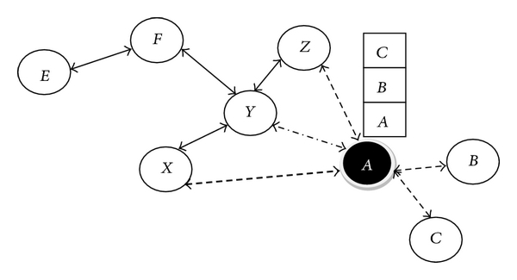
Routing Attacks
Sybil Attack:
In the Sybil attack, a malicious node behaves as if it were a larger number of nodes, for example by impersonating other nodes or simply by claiming false identities.
WSNs vulnerable to this attack, as sensor nodes are deployed in a very unstructured manner
This attack significantly reduce the effectiveness of fault-tolerant schemes such as distributed storage, multipath routing and topology maintenance.

Slide 30
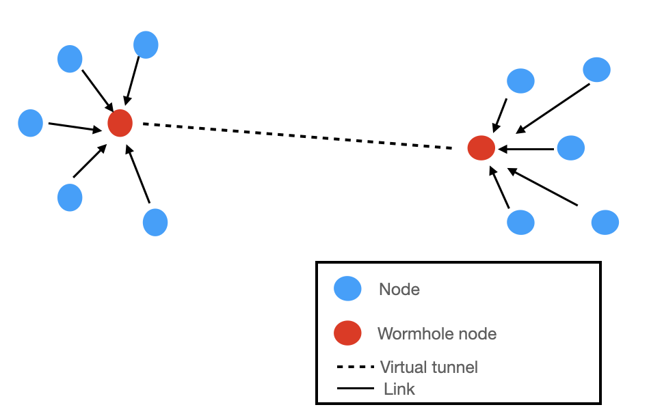
Routing Attacks
Wormhole Attack:
One or more malicious nodes are present who fake the route.
There is a tunnel between these malicious nodes.
As a result, the other nodes in the WSN can be tricked into believing that they are closer to other nodes than they really are which can cause problem in the routing algorithm
The malicious node captures the packets and transmits them to other location.
Wormhole attack can be launched without any knowledge of the network.

Slide 31
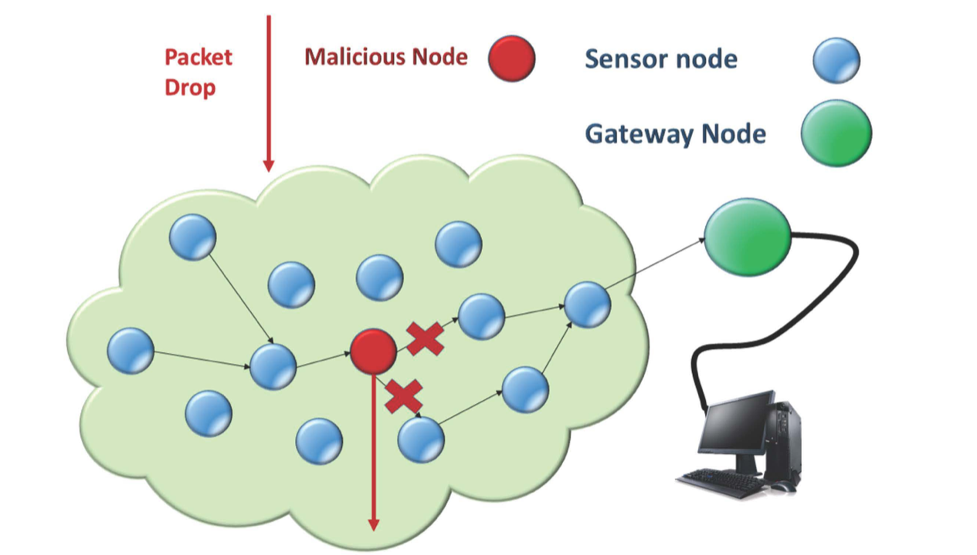
Routing Attacks
Blackhole Attack:
A malicious node advertises the wrong paths as good paths to the source node during the pathfinding process.
When the source selects the path including the attacker node, the traffic starts passing through the adversary node and this node starts dropping the packets selectively or in whole.
Black hole region is the entry point to many harmful attacks.
The attacker can cause Denial Of Service by dropping all the received packets.

Slide 32
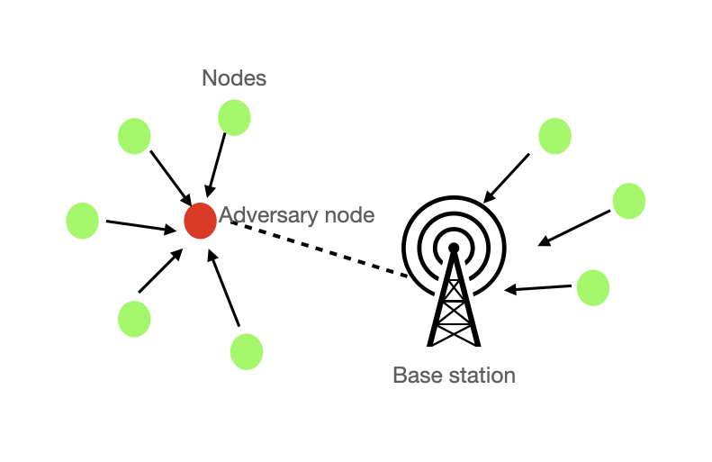
Routing Attacks
Sinkhole Attack:
In a sinkhole attack, the attacker's goal is to lure nearly all the traffic from a particular area through a compromised node, creating a sinkhole with the adversary at the centre like black hole.
Sinkhole attacks typically work by making a compromised node look attractive to surrounding nodes with respect to the routing algorithm.

Slide 33
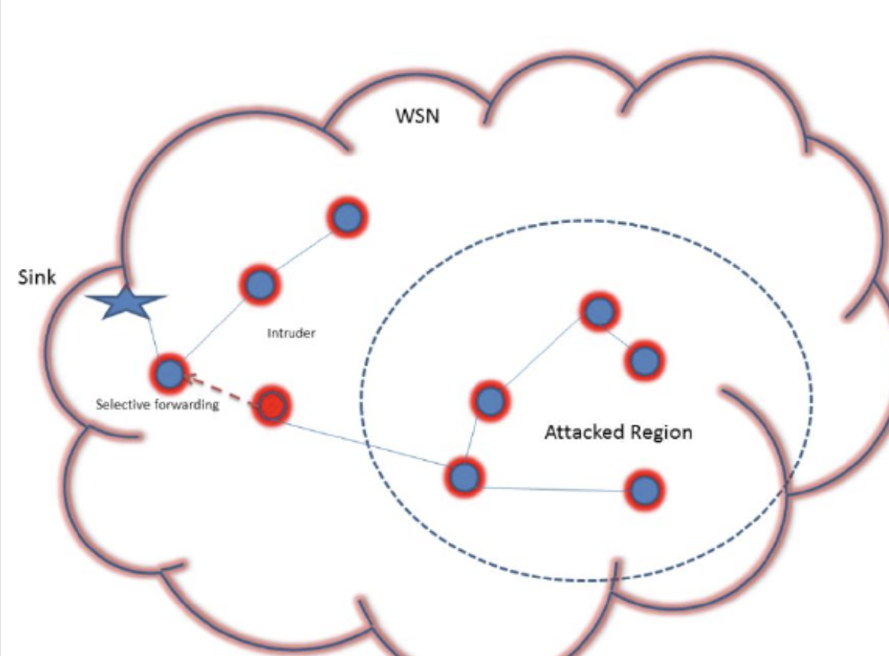
Routing Attacks
Selective Forwarding Attack:
One malicious node denies to forward packets.
Malicious node can deny packets which are coming from a particular node or from selective nodes.
Generally, the attacker remains near the sink, and it cannot be easily detected

Slide 34
Routing Attacks
Acknowledgement Spoofing:
Routing algorithms used in sensor networks sometimes require acknowledgments to be used
Attacker intercepts between sender and receiver.
Spoof the acknowledgement packets.
The main goal is to make the sender convince that a dead node is alive.
It makes the sender confuse and mislead the routing process.

Slide 35
Routing Attacks
Compromised Nodes Attack:
Attacker attacks some nodes of the network.
Attacker wants to steal secret information like security keys from these compromised nodes.
One solution is to use trust protocol, which can differentiate between compromised nodes and uncompromised nodes.

Slide 36
Defence Mechanism for WSN
Detection: When a network node exhibits unusual behavior or differs from its usual functionality, an attack is detected.
Prevention: To make sure that no malicious activity affects a network.
Mitigation: The method to reduce the severity of an attack caused on a network

Slide 37
Detection
Intrusion Detection Systems (IDS) are used to monitor and detect any suspicious activities occurring outside the normal behavioral pattern.
Based on its detection techniques, IDS are of two types:-.
Signature-based IDS: Detects known patterns of intrusions with the help of known set of rules or signatures.
Anomaly-based IDS: Observes the behavior of nodes, profiles the normal behavior and detects any anomalies.

Slide 38
Detection
The network architecture has a significant impact on how effective and efficient the IDS for a WSN is.
Based on that, there are three different types of architectures:
Stand-alone architecture: All nodes work individually to detect any intrusions.
Distributed and cooperative architecture: An intrusion detection agent is placed at each node which cooperates with other local agents to detect any intrusions.
Hierarchical architecture: Used in multi-layered WSN. Consists of multiple clusters with a cluster head(CH) which is responsible for finding any malicious activity happening in the network.

Slide 39
Properties of IDS
Low consumption of resources
Distributive
Local Audit (Local Surveillance)
Distrust of other nodes
Self defense (Security)

Slide 40
Prevention: Passive Attacks
Eavesdropping: Using a strong encryption and decryption method can help prevent eavesdropping.
Traffic analysis: Traffic reshaping technique is used to prevent this type of attack.
A single wireless card is used to construct numerous virtual media access control (MAC) interfaces, which are then dynamically scheduled to reshape the packet features on each virtual interface.
As a result, the adversary cannot infer the users' online actions from the original traffic's characteristics since they are disguised.

Slide 41
Prevention: Active Attacks
DoS: Nodes compete against each other to gain respect in the network and forward incoming packets.
Jamming attack: An exponentially weighted moving average is used to detect the abnormal behavior.
Node replication attack: A location independent protocol helps to prevent illegitimate nodes from joining the network.

Slide 42
Prevention: Routing Attacks
Hello flood: Bidirectional link to guarantee that they may reach their parent within one hop
Spoofing attack: Applying different integrity checking mechanisms like message authentication code (MAC) helps to prevent this attack.
Replay attack: Timestamp or nonce is used with encryption algorithm to identify the old message. Timestamp is more preferred as it requires lesser number of messages compared to nonce.

Slide 43
Prevention: Routing Attacks
Sybil attack: A dynamic and accurate method to detect and prevent Sybil attack is by combining it with Random Password Comparison (RPC) and Message Authentication and Passing method (MAP).
Sinkhole and Wormhole attacks: Making each node use a unique symmetric shared key with the base is a defense mechanism against Wormhole and Sinkhole attacks.
Blackhole attack: By monitoring the network, adjusting packet routing, or employing authentication procedures, a black hole attack can be averted.

Slide 44
Prevention: Routing Attacks
Selective forwarding attack: Sensor nodes use sequence number of the packet to detect an intruder in the WSN.
Compromised nodes attack: Using trust protocol compromised nodes and uncompromised nodes can be differentiated.

Slide 45
Mitigation
The most common mitigation technique in WSN is AODV.
Ad hoc On Demand Distance Vector (AODV) is a routing protocol designed for ad hoc mobile networks.
In AODV, source node generates an RREQ packet and the neighboring nodes forward it to the destination node. The destination node then generates and sends an RREP packet to the source. Subsequently, all the other nodes create a routing table which stores the information about the neighboring node.
Here each node has its own sequence number. When the sender receives multiple RREP packets from various nodes, it stores all of them and calculates an average of all those sequence numbers. The RREP packets having the value of sequence number higher than the average sequence number are discarded by the sender. This way only the route with value less than or equal to S is selected.

Slide 46
Any Queries?
THANK YOU!

